Slide 1
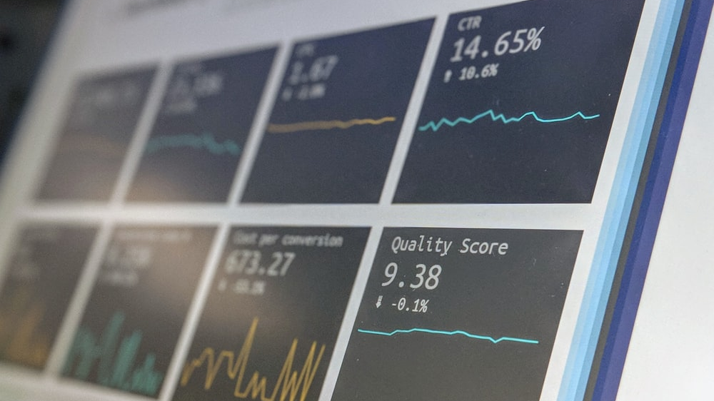
Where/When | Jan | Feb | Mar | Apr
America | 8,756 | 6,543 | 4,568 | 7,496
Canada | 10,102 | 7,234 | 7,496 | 8,029
India | 9,312 | 12,255 | 8,521 | 4,996
China | 5,390 | 9,012 | 5,522 | 6,542
Russia | 5,600 | 3,000 | 5,465 | 7,832
Together: | 39160 | 38044 | 31572 | 34895
Designed Table

Slide 2
Where/When | Jan | Feb | Mar | Apr
America | 8,756 | 6,543 | 4,568 | 7,496
Canada | 10,102 | 7,234 | 7,496 | 8,029
India | 9,312 | 12,255 | 8,521 | 4,996
China | 5,390 | 9,012 | 5,522 | 6,542
Russia | 5,600 | 3,000 | 5,465 | 7,832
Together: | 39160 | 38044 | 31572 | 34895

Slide 3
Where/When | Jan | Feb | Mar | Apr
America | 8,756 | 6,543 | 4,568 | 7,496
Canada | 10,102 | 7,234 | 7,496 | 8,029
India | 9,312 | 12,255 | 8,521 | 4,996
China | 5,390 | 9,012 | 5,522 | 6,542
Russia | 5,600 | 3,000 | 100 | 100
Together: | 39160 | 38044 | 26207 | 27163
Table title

